Slide 1

Credit one
Customer Credit Default Probability

Slide 2
Business
Goals
To determine if the credit for the customer should be approved or not
To estimate how much credit should be assigned to the customer
Background & Scope
Credit One has seen an increase in the number of customers who have defaulted on loans
There is a need to implement a creative, empirically sound solution
The first need is to define the problem within a data science framework

Slide 3
Analysis PLAN
The goal of this analysis is to find out if the variables and their types are adequate to accomplish the Business Goals
The Hypothesis for this project are:
1. Gender, Education, Marital status Age, and Payment History estimate if the credit should be issued or not
2. Default status for Next Month, Amount of Bill Statement, and Paid Amount can estimate how much credit should be granted
The available data includes
Gender
Education
Marital Status
Age
Payment History,
Default For Next Month,
Amount Of Bill Statement
Amount Paid
METHODOLOGY : Regression methods will be used for this project

Slide 4
Project plan
Milestones: Load Data
Datatype validation
Determining relations between variables
Choosing Variables for the estimation model
Risks: Data Base error
Python Environment not working properly
Uncleaned data
Choosing wrong variables for model

Slide 5
Data
The data will be obtained from Credit One and its MySQL database stored at (34.73.222.197/deepanalytics) and will be cleansed and validated using the following procedure
To:
Retrieve data
Start Exploratory Data Analysis
Store data
Review Descriptive Statistics
Check Headers
Check Histograms for variables
Remove unusable headers
Analyze interactions between vars
Rename inconsistent headers
Analyze correlations between vars
Remove duplicate data
Analyze covariances between vars
Check if data is numeric
Sex
Education
Marital status
Age (Discretized)
Payment History
Default status
Build model(s)
Transform nonnumeric data (dummy vars, label encoding)
Evaluate model(s)
Start Exploratory Data Analysis

Slide 6
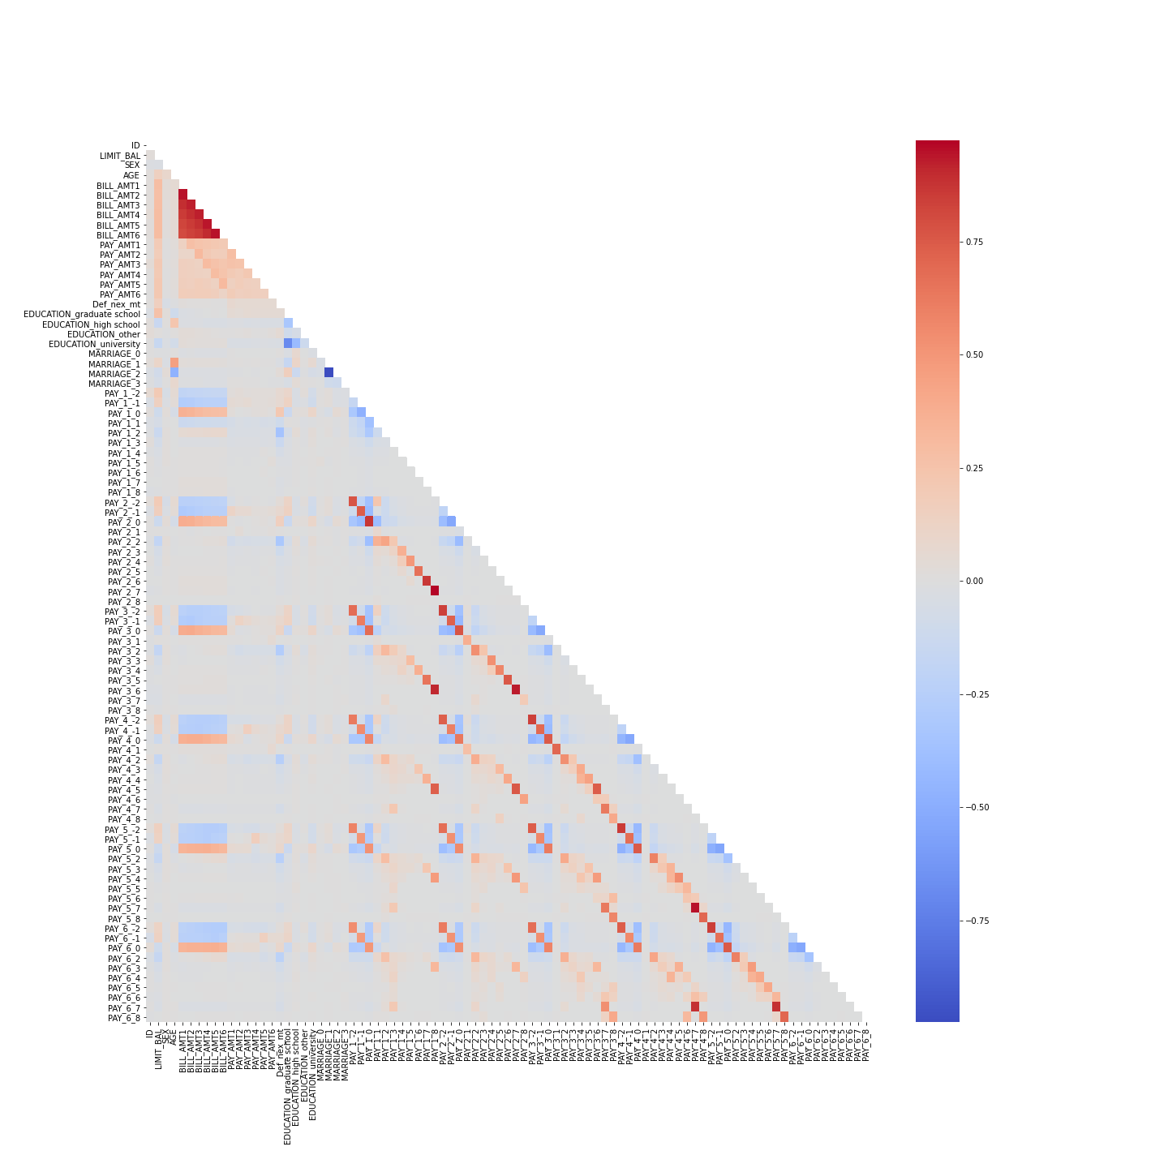
Insights
The following data needs to be transformed into numeric values (dummy variables or label encoding)
Sex
Education
Marital status
Age (Discretized)
Payment History
Default status
Proven or disproven Hypotheses
For the first Hypothesis the selected data proves to be suitable for estimating approval or denial of credit
For the second Hypothesis the selected data also proves to be suitable for credit estimation amount
How much confidence should stakeholders place in the results?
How do you rank your findings in terms of quantified impact on the business?

Slide 7
These are some insights from the data analysis performed:
After cleaning and transforming the data a total of 82 variables are being used
Each model should not use all the features
Some of the variables (such as pay amount and bill amount, Education and pay history) are slightly correlated
Most of the variables (such as Age and pay amount, Age and Bill amount) have no correlation
Most of the features present some level of skewness, and will need normalization

Slide 8
Most of the features show spikes in the histograms
The features in need of transformation to “dummy variables” are: Sex, Education, Marital status, Age (Discretized), Payment History, and Default status. It was performed with one-hot-encoding and label encoding
Most of the variables related to amounts paid, billed or in statements present one or two data far off from the normal values causing heteroskedasticity
Some of the features might explain other variables causing autocorrelation, must use caution choosing which features will be part of the model.

Slide 9
Recommendation
How can you most effectively present the results of your analysis to your stakeholders (in terms they can understand and in alignment with information they’ll value)?
1. The available data for this project is useful, but additional information such as: Income, Employment Situation, Household Income, Debt To Income Ratio, Liabilities, etc. can be valuable to improve the estimations
2.The decision about enrolling customers in the client’s credit programs would be enhanced if it applies both models, first determining if the credit should be issued, and then how much credit may be assigned
3. It is important to notice that since the goals tacitly involve avoiding loss of customers and revenue for the client and Credit One, some of the requirements may be softened in a case-by case basis, keeping in mind high risk customers – showing signs of probable default in payments- should only represent a small portion of the total credits issued.

